Slide 1
The Big Picture
“To properly understand the big picture, everyone should fear becoming obsessed with one small section of truth.” ~ Xun Zi

Slide 2

Mission…
“Using the information and skills gained in the previous exercises assess the mapped architecture for risk and testability”

Slide 3

Objectives…
Learning Objectives:
Identify areas of potential technical & business risk
Apply the principles of testability to enhance your testing effort

Slide 4

Introducing Risk
Thinking in models
Bigger Picture
Focused on value

Slide 5

Risk Modelling…
FIBLOTS!
Test Ideas!
Example!
Back to your diagrams!

Slide 6
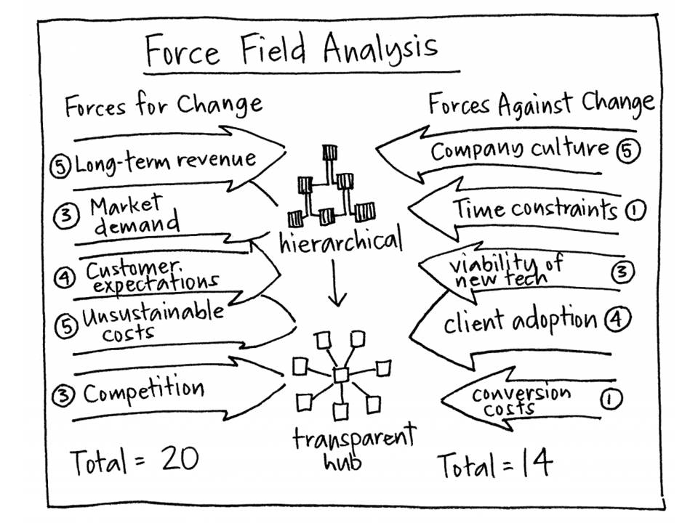
Exercise 2 Interaction Risk Modelling…
Different Groups (again)!
Force Field!
Communication/Translation!
External & Internal
Error Handling!
Recovery!
Test Ideas!

Slide 7
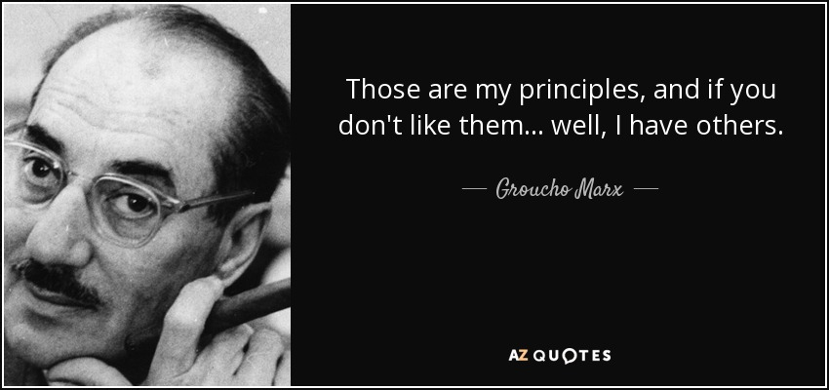
Introducing Testability…

Slide 8

Applying Testability
Focus on risk!
Example!
Previous diagrams!

Slide 9

Summarise…
It’s me…
It’s you…

